Slide 1
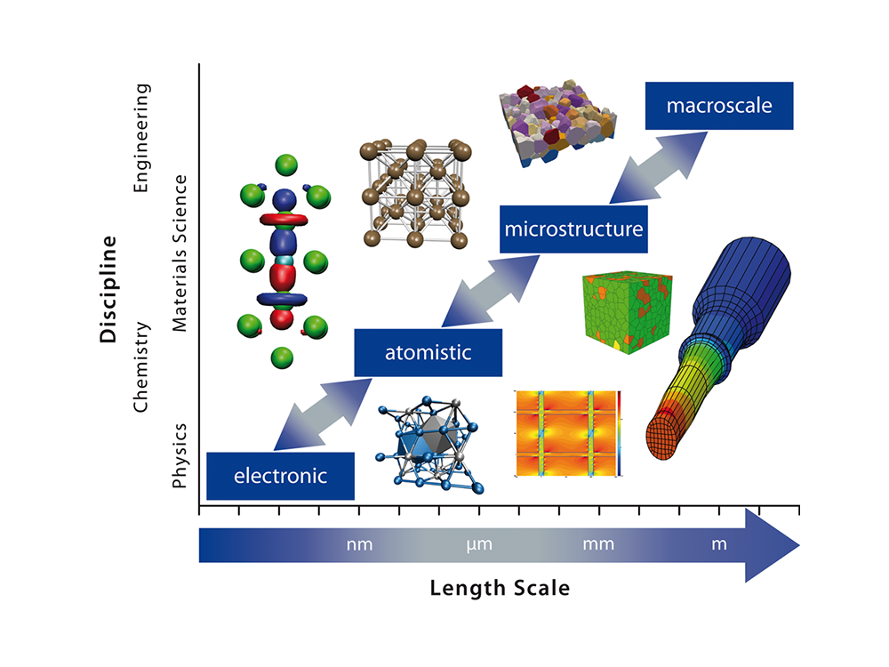
MLL213: Materials Modelling
Prof N S Harsha Gunda
Department of Materials Science and Engineering
IIT Delhi
Office: 306H, Academic Complex West
Email: gnsharsha@iitd.ac.in

Slide 2
Why should we care for computations
Reduction of experiments and material development timeframe
Theoretical models have often beat experiments in discovery.
It is the only way to understand basic fundamental physics.
Develop advanced models to predict many material properties of interest accurately
Its cool ☺

Slide 3
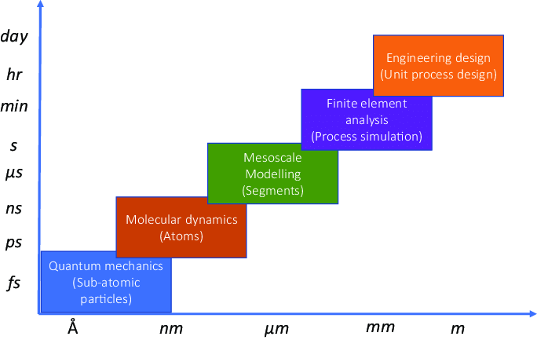
Scales on Material Simulations

Slide 4
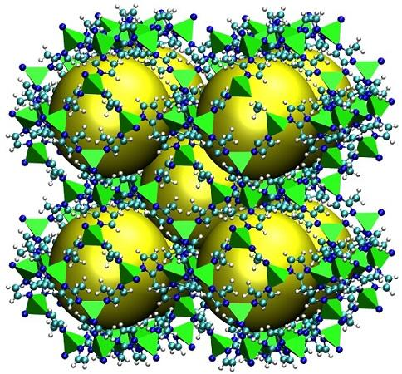
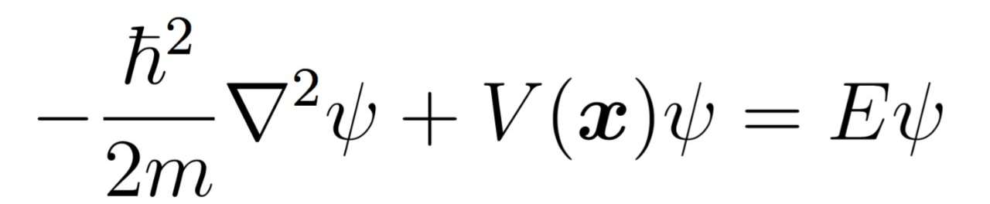
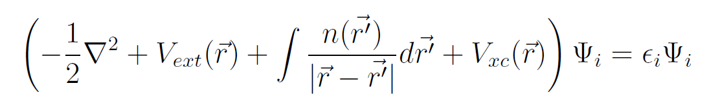
Density Functional Theory
Atomistic Simulations
Schrodinger Equation:
Simplification from DFT
First-Principles methods. Physics-based modeling.
Structure and energy optimization.
Very good prediction of fundamental properties.
Computationally expensive. Simulate < 100 atoms only

Slide 5
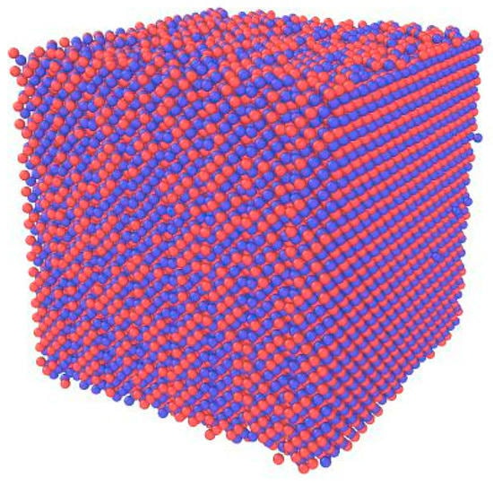
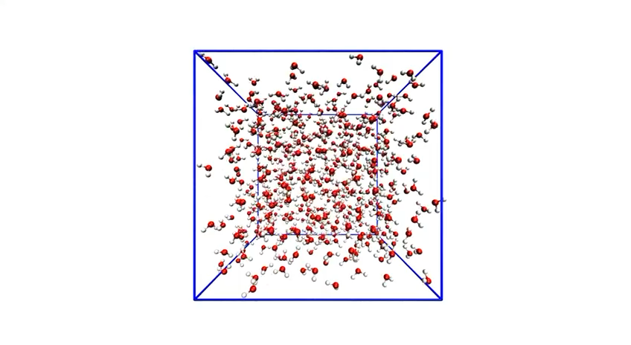
Molecular Dynamics
Atomistic Simulations
Inter atomic potential
Newtonian mechanics
F = ma
Simulate millions of atoms at a time.

Slide 6
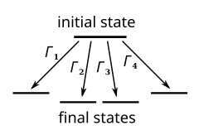
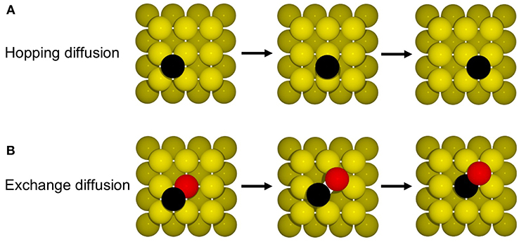
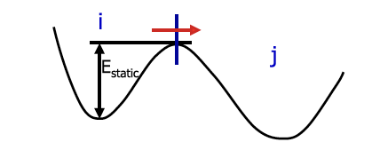
Kinetic Monte Carlo
Atomistic Simulations
Used to understand the time evolution of the various processes in nature
Very useful to simulate processes like diffusion

Slide 7
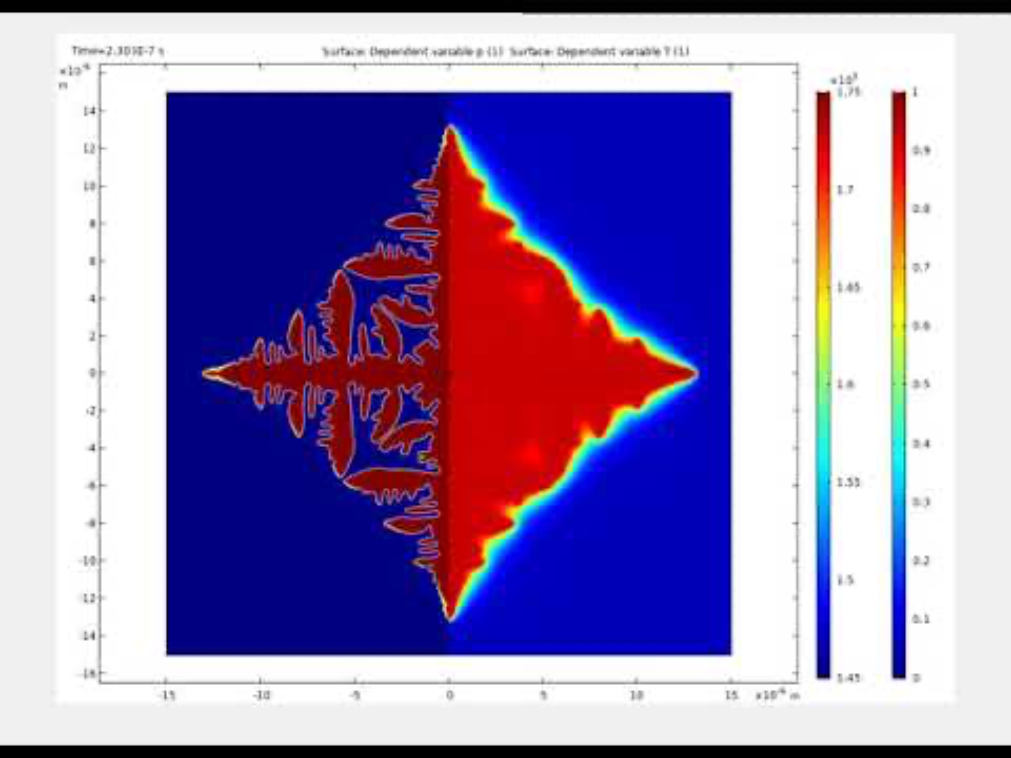
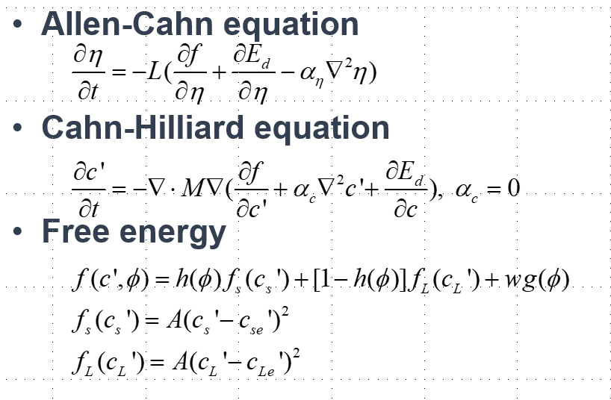
Phase field simulations
Mesoscale simulations
Model evolution of microstructure under various conditions.

Slide 8
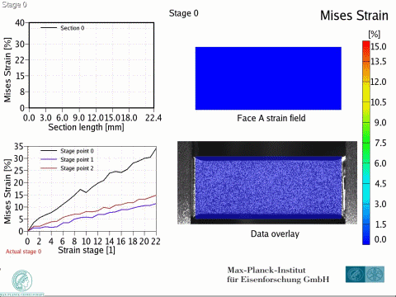
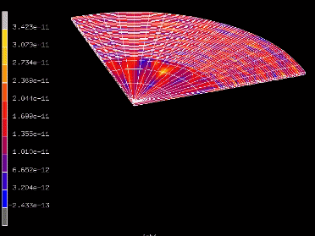
Crystal Plasticity
Mesoscale simulations
Model developed using Finite element method
Model the deformation of materials under stress/strain.
Uses the mechanical properties of materials to predict deformation

Slide 9
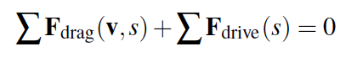
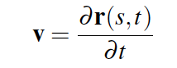
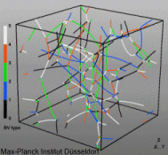
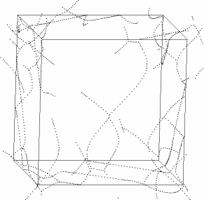
Dislocation dynamics
Mesoscale simulations
Model the motion of the dislocation to predict mechanical properties

Slide 10
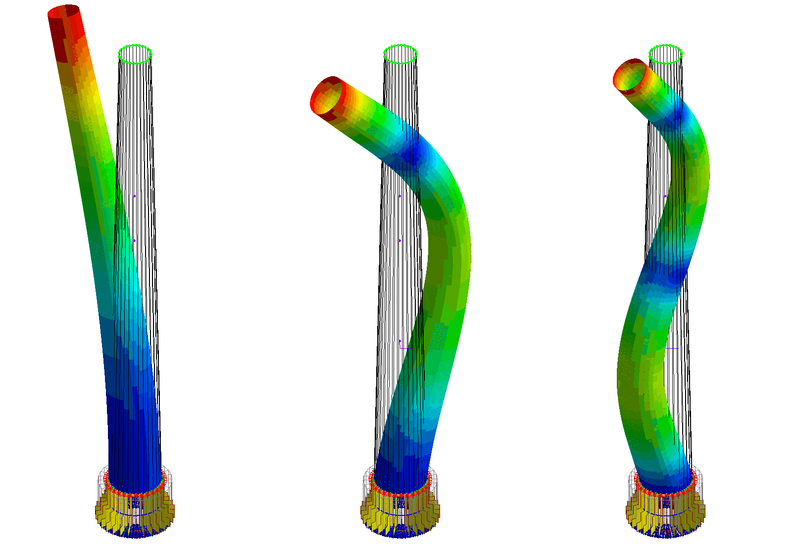
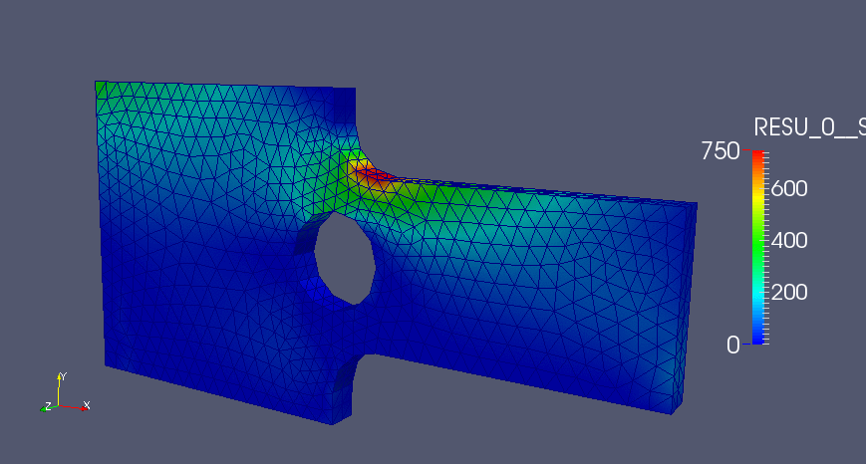
Finite Element modeling
Continuum simulations
Modeling method to solve differential equation using approximation schemes

Slide 11
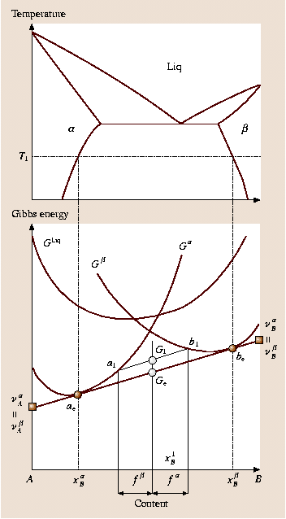
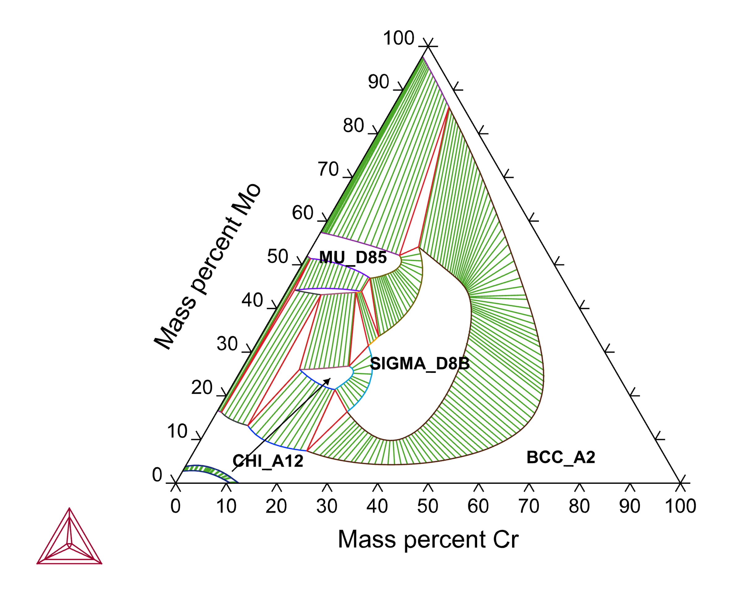

Thermodynamic modeling
Materials Models
Makes models of free energies of the phases present in the system.
Useful for phase stability analysis, phase diagram construction and microstructure prediction

Slide 12

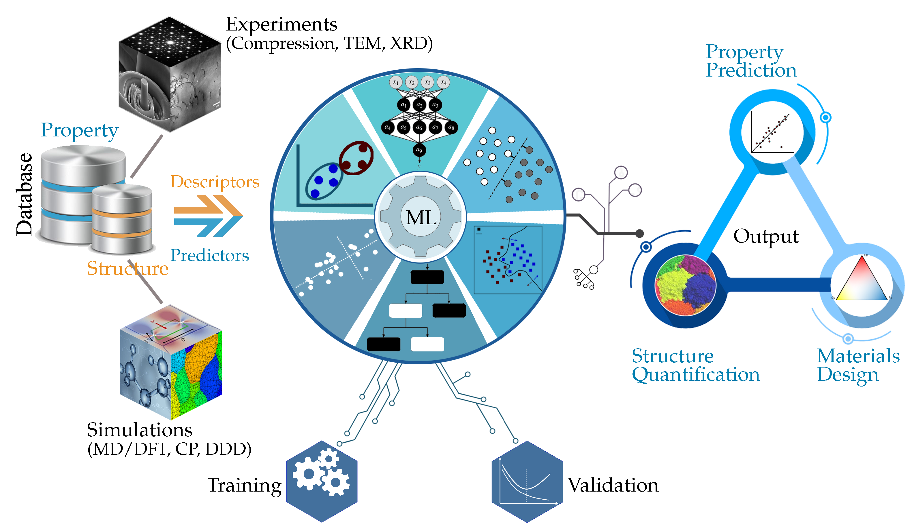
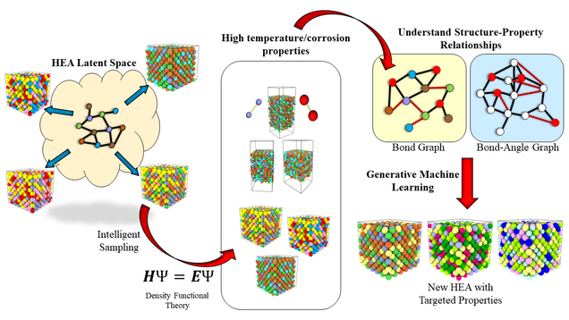
Materials Informatics
Materials Models
Last decade has a significant growth of ML application in Material science
Many open-source material modeling packages available online
Materials Design

Slide 13
Interatomic Potentials

Slide 14
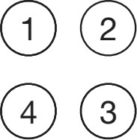
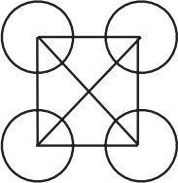


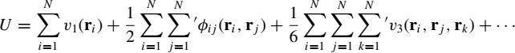
Interactions between atoms
External field
Pair potential
Three-body
…….

Slide 15
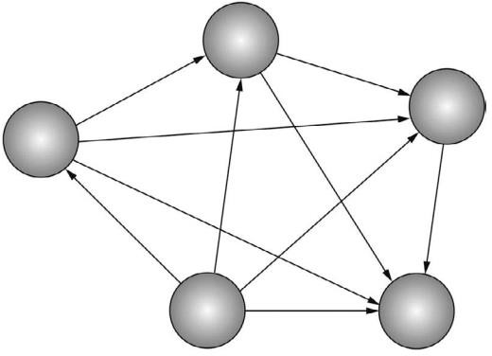
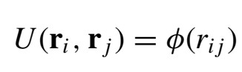
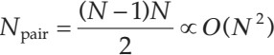
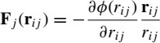
Central-Force potentials
We will come across a number of systems in which the interaction potential between two particles is a function only of the distance between them – these are called central-force potentials

Slide 16
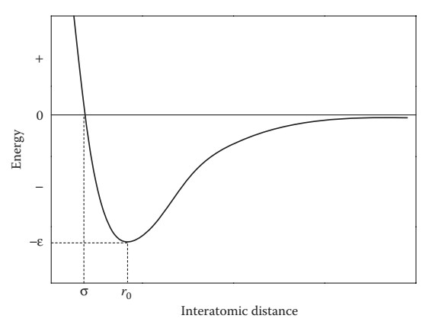
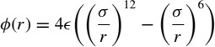
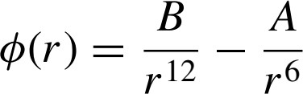
Lennard-Jones (LJ) pair potential
A typical example is the Lennard−Jones potential (Lennard−Jones 1924)
parameter ε is the lowest energy of the potential curve (≡ well depth, cohesive energy), parameter σ is the interatomic distance at which the potential is zero
At equilibrium interatomic distance, r₀, two forces are balanced to a net force of zero, and the corresponding energy becomes minimum (dU_{LJ}/dr = 0)

Slide 17
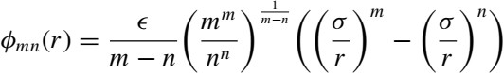
Mie Potential
Improvements can be made to the Lennard-Jones potential by adding additional parameters. One approach would be to have the exponents in the 1/r¹² and 1/r⁶ parts of the potential be adjustable parameters, i.e., instead of r⁻¹², perhaps r⁻¹¹ would be a better description of the short- range interactions in some systems.
A variation of the Lennard-Jones form, called the Mie potential (or the mn Lennard-Jones potential), takes this approach, replacing 1/r¹² with 1/r^{m} and 1/r⁶ with 1/r^{n}. Writing the Mie potential as

Slide 18
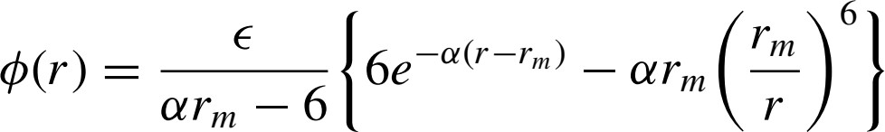

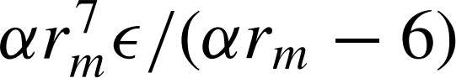
Other potentials
Buckingham potential
𝜙 𝑟 = 𝐴𝑒^{−𝛼𝑟} − ^{𝐶}
_{𝑟}6
Often used for Ionic systems where electrostatic interactions are included.

Slide 19
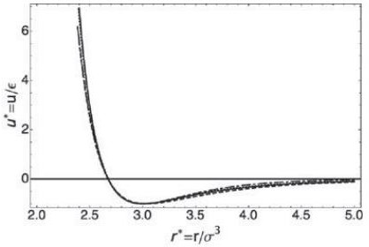
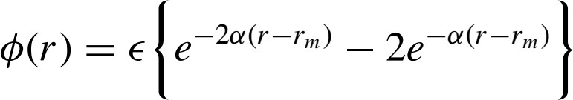
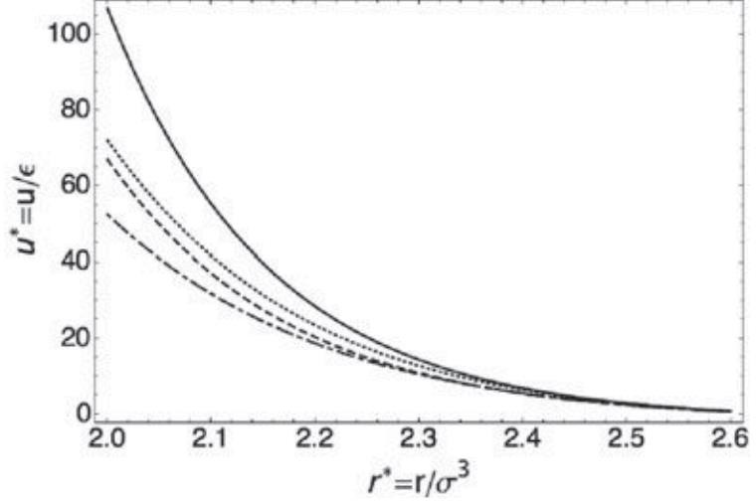

Other potentials
Morse potential
r_{m} is the position of the minimum,є is the well depth, and α governs the shape of the potential. The Morse potential has a very soft repulsive wall and is sometimes used to model interatomic interactions in metals.
The interaction at long range falls off much more quickly than the van der Waals energy
LJ

Slide 20
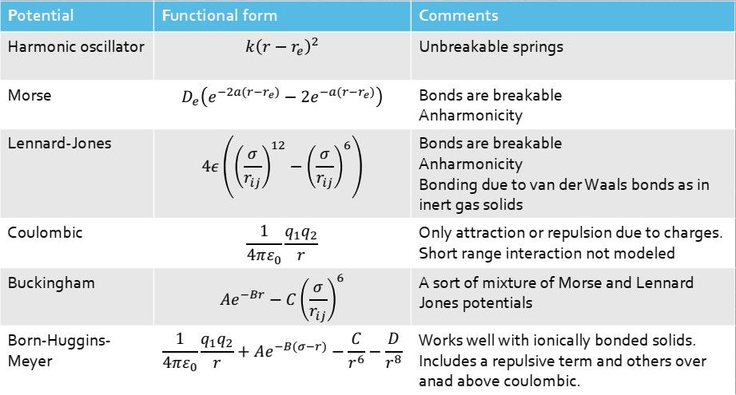
Summary of Central force potentials

Slide 21
Advantages & disadvantages of CFP
Advantages
Simplicity
Ability to make easy models and hypothetical systems
Computational ease
Disadvantages
Problem of accuracy
The use of the common Lennard-Jones potential limited to inert gases, where no electrons are available for bonding & atoms are attracted to each other only through van der Waals forces.
Problems in metallically, ionically and covalently bonded systems with respect to cohesive energy, elastic constants, etc.

